Slide 1

Transform Data with

Slide 2



https://r4ds.hadley.nz/
Complete and free online
The ultimate resource for most of today

Slide 3
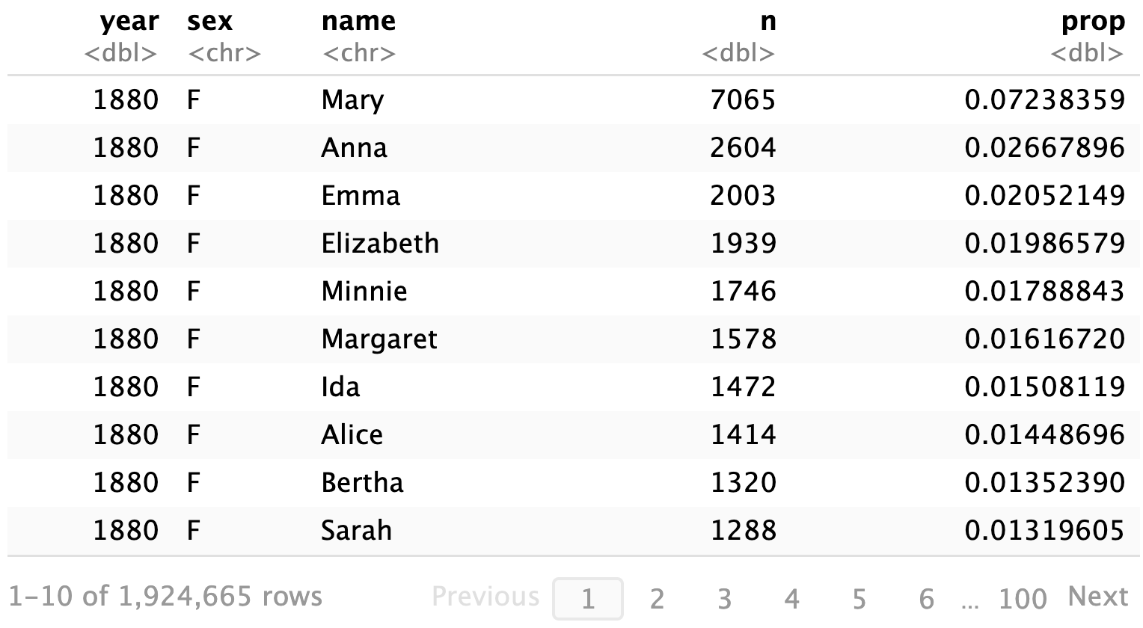
babynames

Slide 4
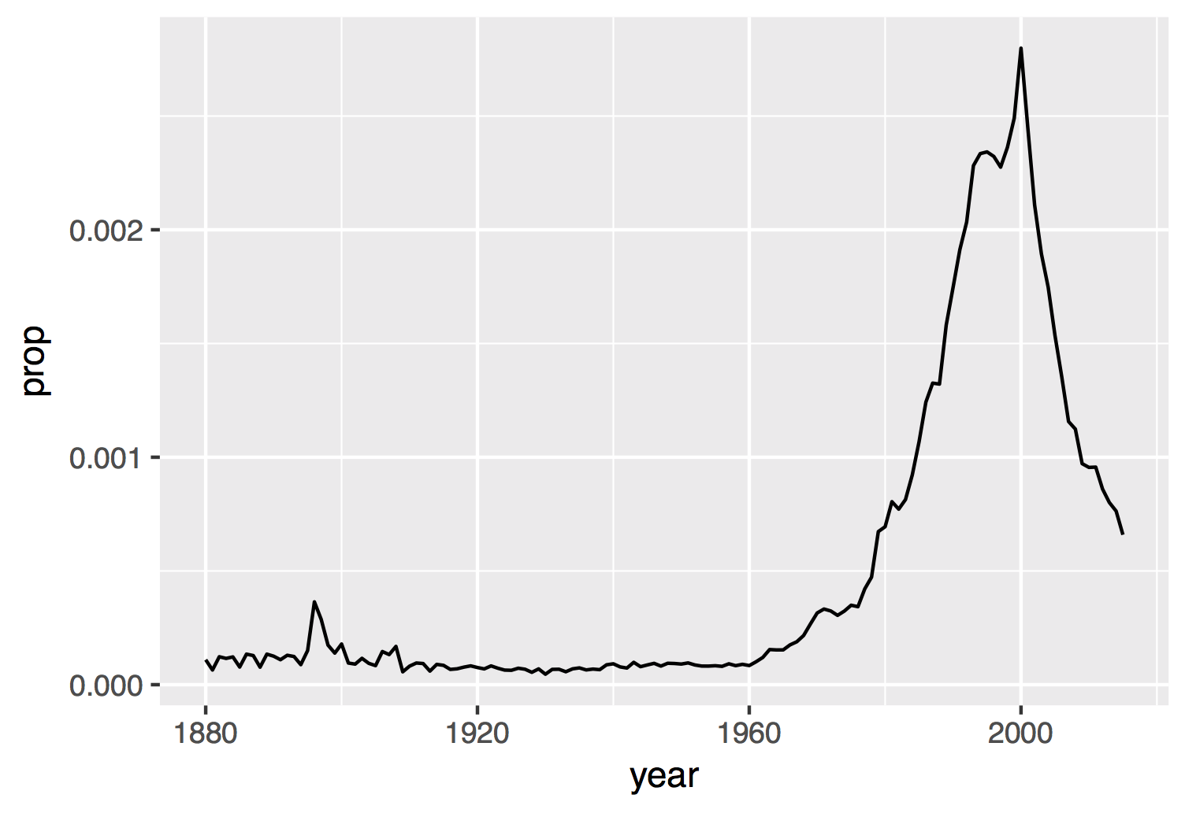
Proportion of boys with the name Garrett

Slide 5
Visualize
Import
Tidy
Model
Reason
Communicate
Transform
Program

Slide 6
Visualize
Import
Tidy
Model
Reason
Communicate
Transform
Program

Slide 7

babynames.csv
Names and sex of babies born in the US from 1880 to 2017. 1.9M rows.
year,sex,name,n,prop
1880,F,Mary,7065,0.07238359
1880,F,Anna,2604,0.02667896
1880,F,Emma,2003,0.02052149
1880,F,Elizabeth,1939,0.01986579
1880,F,Minnie,1746,0.01788843
1880,F,Margaret,1578,0.0161672
1880,F,Ida,1472,0.01508119
1880,F,Alice,1414,0.01448696

Slide 8

babynames.csv
year,sex,name,n,prop
1880,F,Mary,7065,0.07238359
1880,F,Anna,2604,0.02667896
1880,F,Emma,2003,0.02052149
1880,F,Elizabeth,1939,0.01986579
1880,F,Minnie,1746,0.01788843
1880,F,Margaret,1578,0.0161672
1880,F,Ida,1472,0.01508119
1880,F,Alice,1414,0.01448696

Slide 9

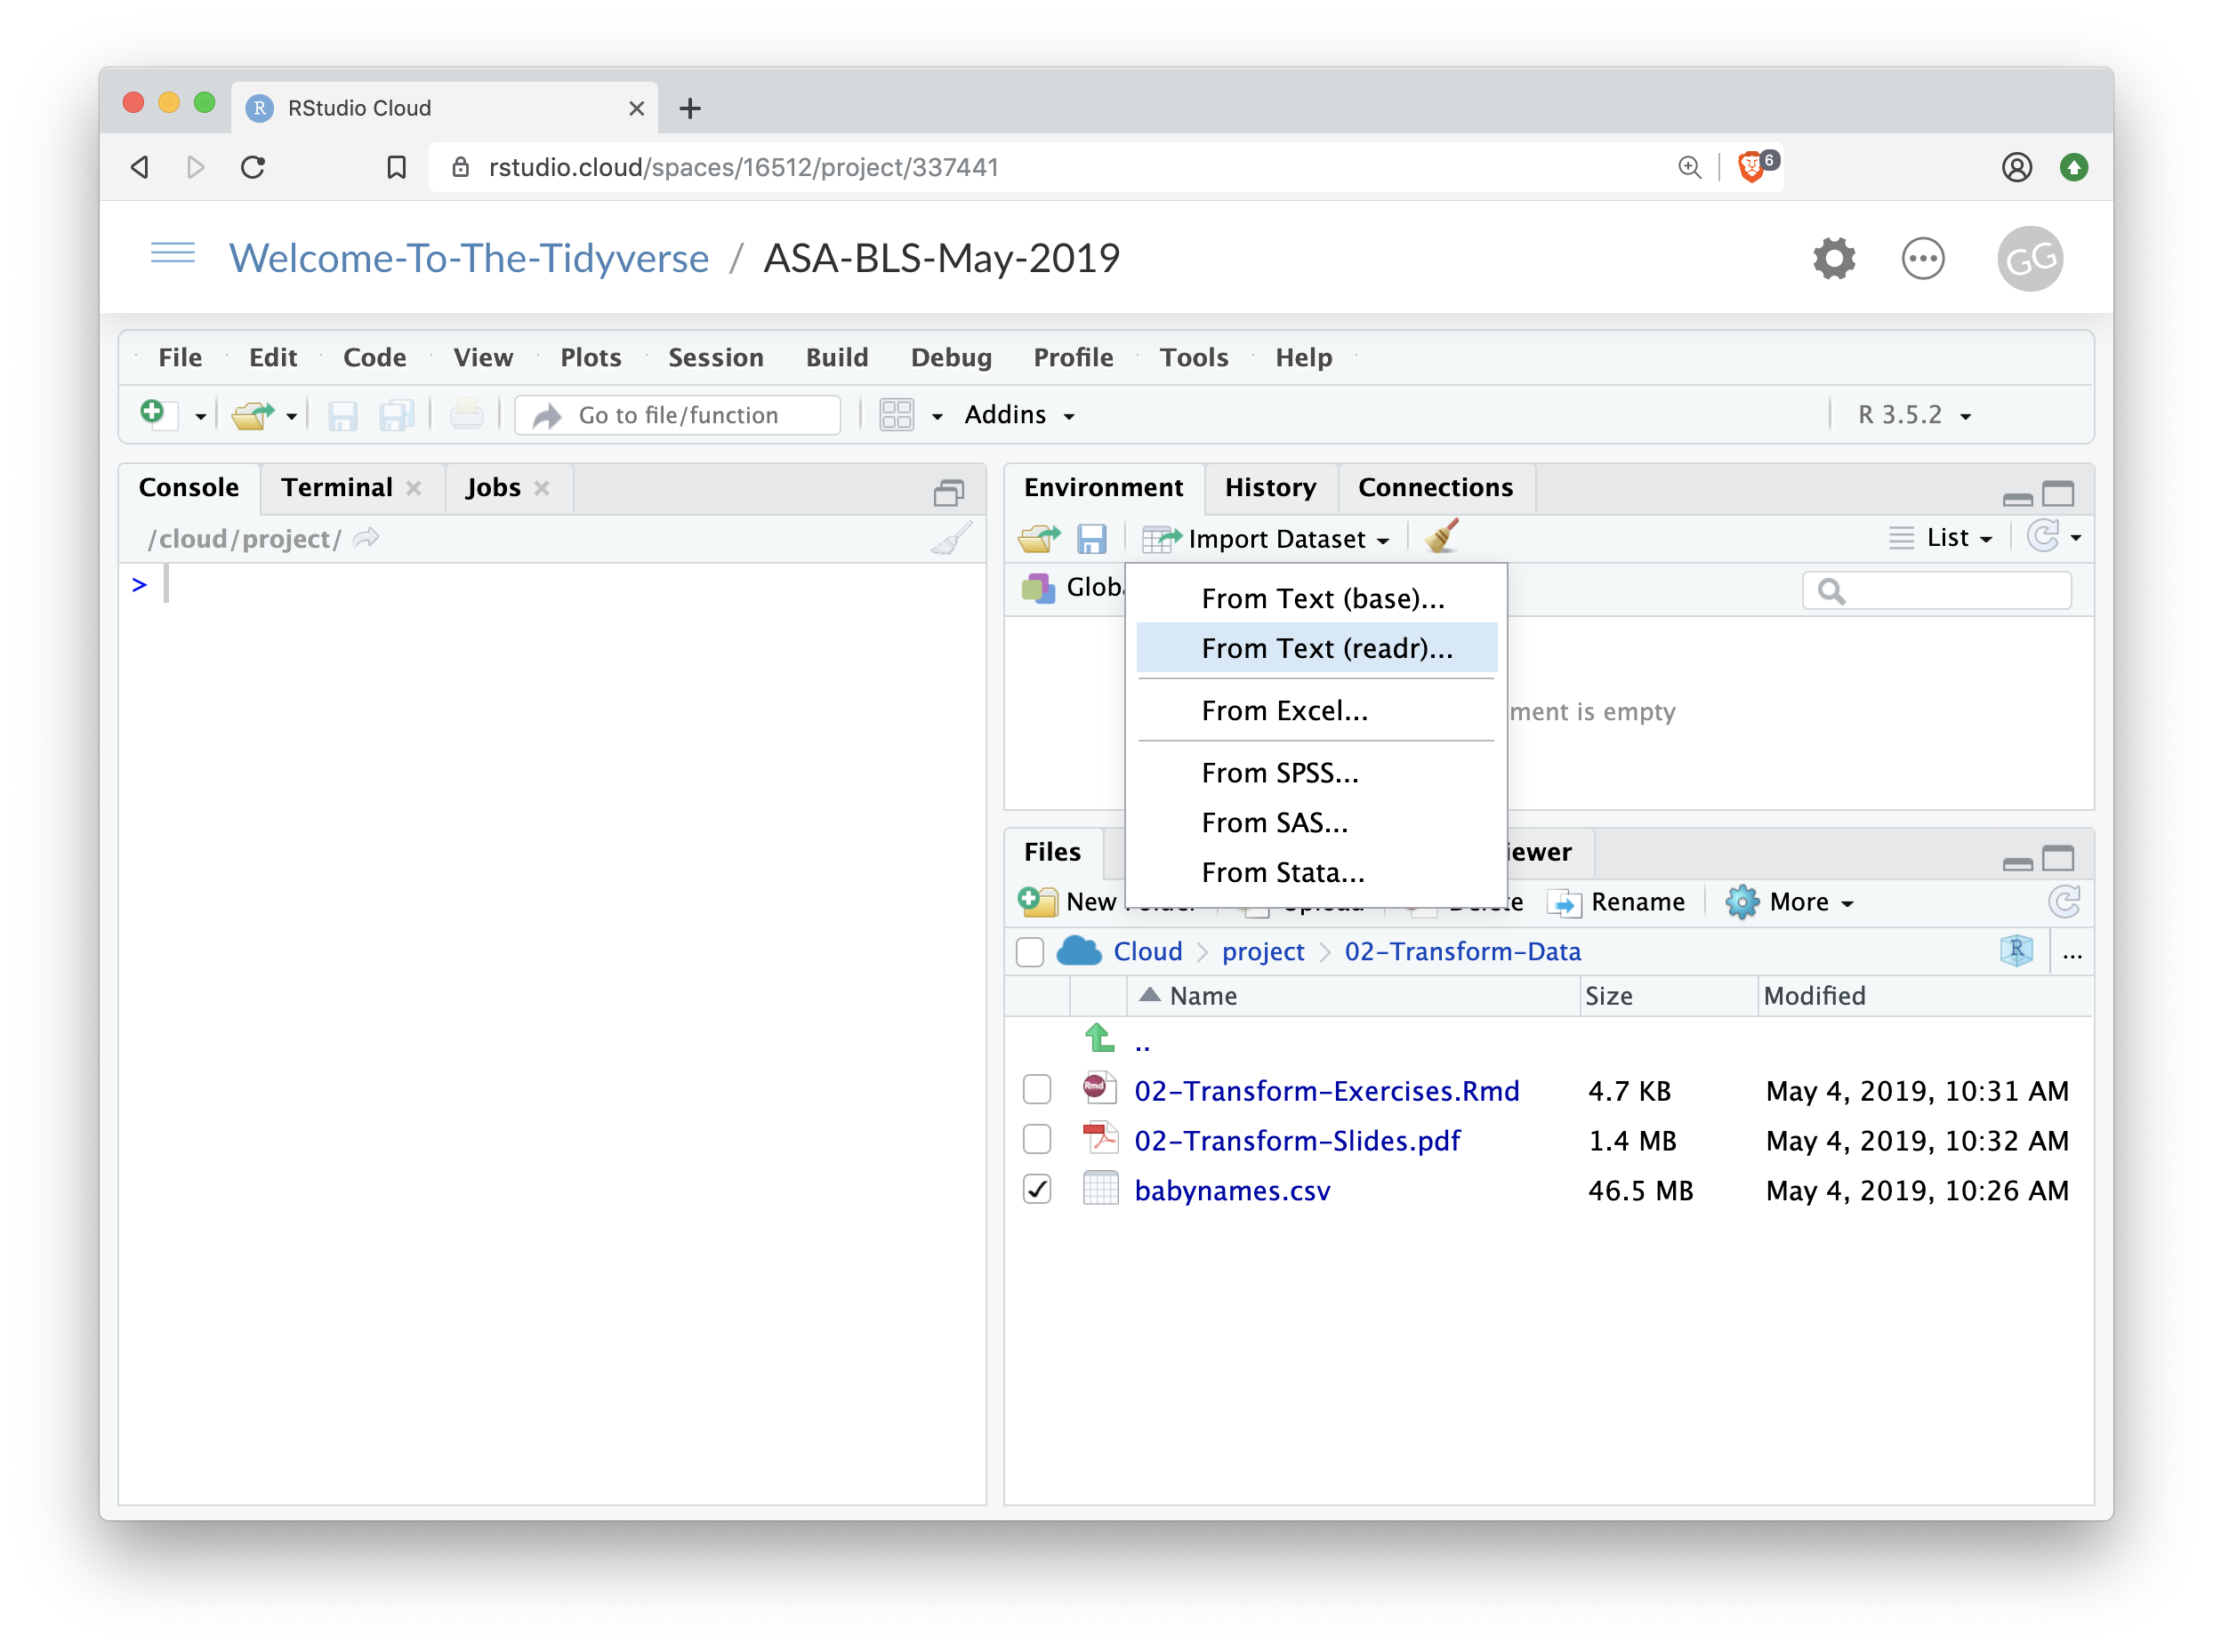

Import
Click Import Dataset From Text (readr)…
9

Slide 10
But is this reproducible?
Why would that matter?
10

Slide 11
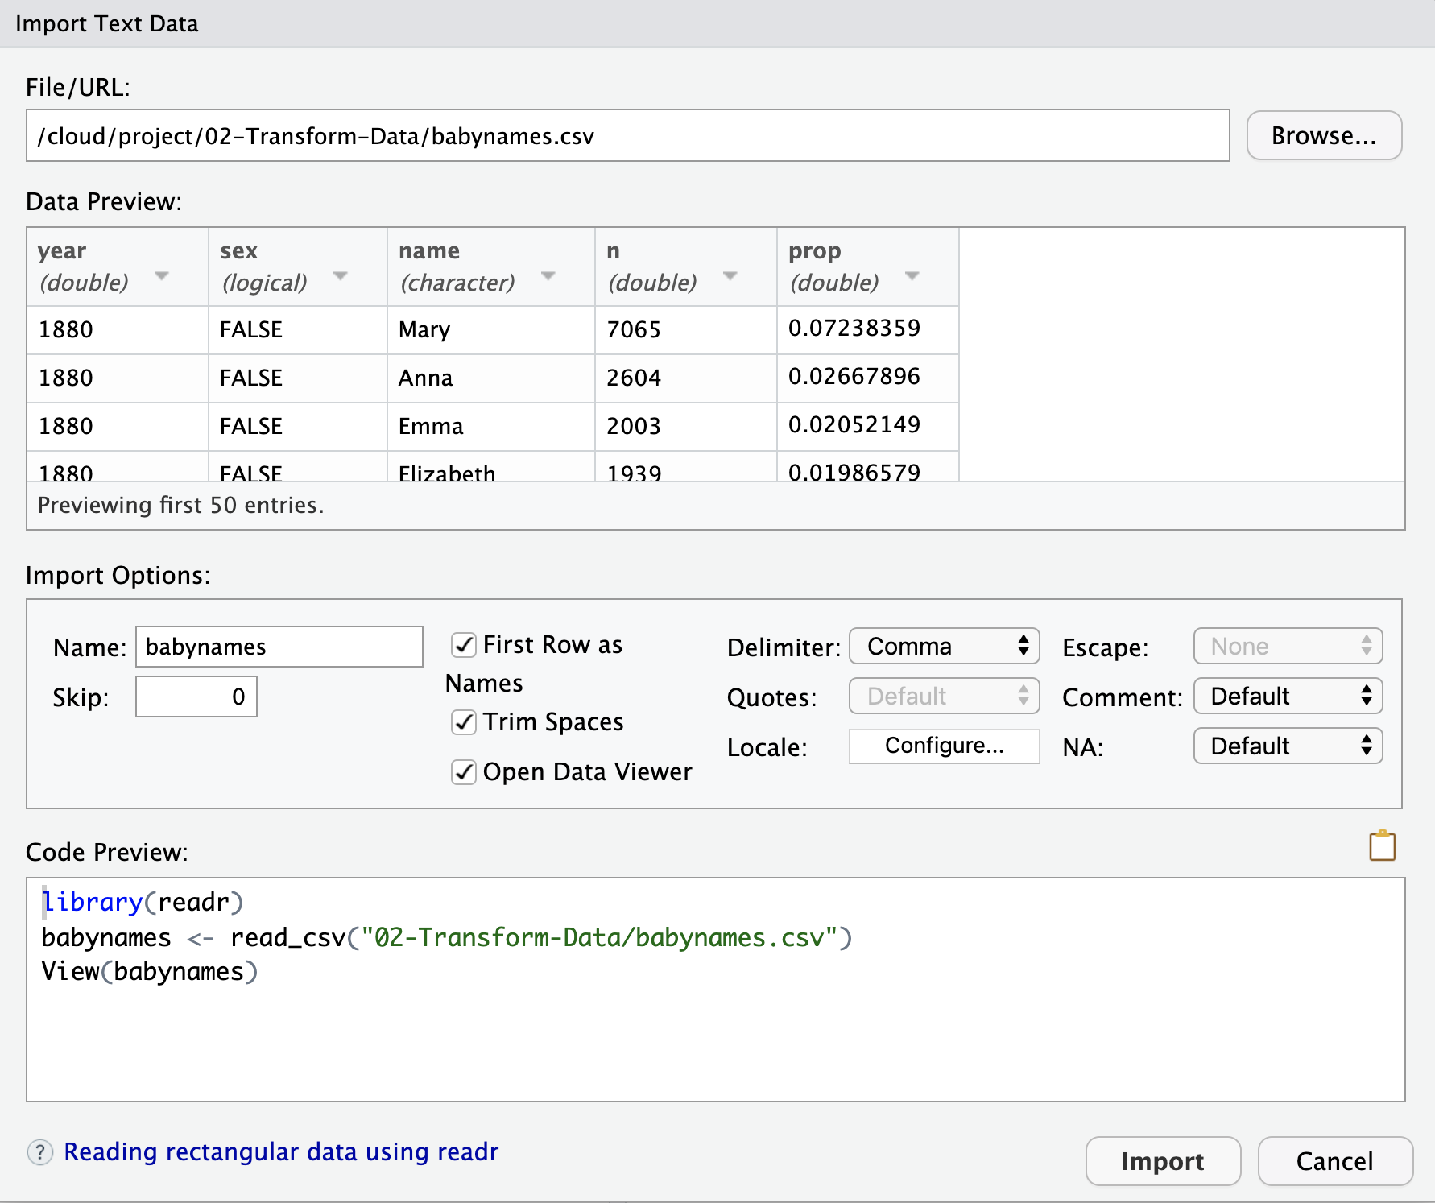

The Code Equivalent

Slide 12
Dealing with file paths
R starts looking for files in a working directory – which you can define: setwd()
But: scripts with setwd() will only work on your current machine.
And: working directory is clear when you run code within Rmarkdown or when you knit … the folder where the Rmd-file is saved.
Recommended:
Keep Rmd and data in same folder or data in subfolder
In same folder: use filenames only
In sub-folder: data/filename
Run all file-related commands in chunks, not Console
Select files with auto-complete – type read_csv(“TAB
Or: use RStudio Projects and the here package
here(“data”, “mydata.csv”) gives same path in Console and RMarkdown
12

Slide 13
Visualize
Import
!!
Tidy
Model
Reason
Communicate
Transform
Program

Slide 14
Your Turn 1
Import the babynames.csv dataset. Give it the name babynames.
If you use the visual menu, copy the import code into the setup code chunk in 03-Transform-Exercises and adjust the file path (so the document can reload it later).
02:00
14

Slide 15

write_csv()
Saves data set as a csv on your computer.
write_csv(babynames, path = "babynames.csv")
Table to save
file
path to save at
15

Slide 16
Visualize
Import
Tidy
Model
Communicate
Transform
Program
16

Slide 17
babynames

Slide 18
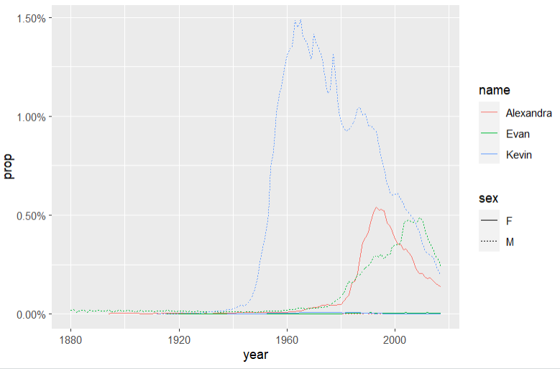
Who has the most popular name?
Which geom?
Notes:
Or least unique?

Slide 19
How to isolate Garrett?
year | sex | name | n | prop
1880 | M | John | 9655 | 0.0815
1880 | M | William | 9532 | 0.0805
1880 | M | James | 5927 | 0.0501
1880 | M | Charles | 5348 | 0.0451
1880 | M | Garrett | 13 | 0.0001
1881 | M | John | 8769 | 0.081
1881 | M | William | 8524 | 0.0787
1881 | M | James | 5442 | 0.0503
1881 | M | Charles | 4664 | 0.0431
1881 | M | Garrett | 7 | 0.0001
1881 | M | Gideon | 7 | 0.0001
year | name | prop
1880 | Garrett | 0.0001
1881 | Garrett | 0.0001
… | Garrett | …
19

Slide 20

dplyr

Slide 21
dplyr
A package that transforms data.
dplyr implements a grammar for transforming tabular data.
21

Slide 22
Isolating data
filter() - extract cases/rows
arrange() - reorder cases/rows
select() - extract variables/columns
22

Slide 23
filter()

Slide 24
filter()
Extract rows that meet logical criteria.
filter(.data, … )
data frame to transform
one or more logical tests (filter returns each row for which the test is TRUE)
24

Slide 25
filter()
Extract rows that meet logical criteria.
filter(babynames, name == "Garrett")
babynames
year | sex | name | n | prop
1880 | M | John | 9655 | 0.0815
1880 | M | William | 9532 | 0.0805
1880 | M | James | 5927 | 0.0501
1880 | M | Charles | 5348 | 0.0451
1880 | M | Garrett | 13 | 0.0001
1881 | M | John | 8769 | 0.081
1881 | M | William | 8524 | 0.0787
1881 | M | James | 5442 | 0.0503
1881 | M | Charles | 4664 | 0.0431
1881 | M | Garrett | 7 | 0.0001
1881 | M | Gideon | 7 | 0.0001
year | sex | name | n | prop
1880 | M | Garrett | 13 | 0.0001
1881 | M | Garrett | 7 | 0.0001
… | … | Garrett | … | …
25

Slide 26
filter()
Extract rows that meet logical criteria.
filter(babynames, name == "Garrett")
= sets
(returns nothing)
== tests if equal
(returns TRUE or FALSE)
babynames
year | sex | name | n | prop
1880 | M | John | 9655 | 0.0815
1880 | M | William | 9532 | 0.0805
1880 | M | James | 5927 | 0.0501
1880 | M | Charles | 5348 | 0.0451
1880 | M | Garrett | 13 | 0.0001
1881 | M | John | 8769 | 0.081
1881 | M | William | 8524 | 0.0787
1881 | M | James | 5442 | 0.0503
1881 | M | Charles | 4664 | 0.0431
1881 | M | Garrett | 7 | 0.0001
1881 | M | Gideon | 7 | 0.0001
26

Slide 27
Logical tests
?Comparison
x < y | Less than
x > y | Greater than
x == y | Equal to
x <= y | Less than or equal to
x >= y | Greater than or equal to
x != y | Not equal to
x %in% y | Is element of a vector
is.na(x) | Is NA
!is.na(x) | Is not NA
27

Slide 28
x <- 1
x >= 2
# FALSE
28

Slide 29
x <- c(1, 2, 3)
x >= 2
# FALSE TRUE TRUE
29

Slide 30
Pop Quiz
What might NA stand for?
1
"1"
"one"
NA
30

Slide 31

Pop Quiz
What might NA stand for?
1
"1"
"one"
NA
Missing Value (Not Available)
31

Slide 32
Note: NA is strong
1 == 1
TRUE
1 == NA
NA
NA == NA
NA
32

Slide 33
Pop Quiz
What is the result?
is.na(NA)
33

Slide 34
Pop Quiz
What is the result?
is.na(NA)
TRUE
34

Slide 35
Logical tests
?Comparison
x < y | Less than
x > y | Greater than
x == y | Equal to
x <= y | Less than or equal to
x >= y | Greater than or equal to
x != y | Not equal to
x %in% y | Group membership
is.na(x) | Is NA
!is.na(x) | Is not NA
35

Slide 36
Your Turn 2
Use filter, babynames, and the logical operators to find:
• All rows where prop is greater than or equal to 0.08
• All children named “Sea”
03:00
36

Slide 37
filter(babynames, prop >= 0.08)
# year sex name n prop
# 1 1880 M John 9655 0.08154630
# 2 1880 M William 9531 0.08049899
# 3 1881 M John 8769 0.08098299
filter(babynames, name == "Sea")
# year sex name n prop
# 1 1982 F Sea 5 2.756771e-06
# 2 1985 M Sea 6 3.119547e-06
# 3 1986 M Sea 5 2.603512e-06
# 4 1998 F Sea 5 2.580377e-06
37
Notes:
Does the second list seem complete?

Slide 38
Two common mistakes
1. Using = instead of ==
filter(babynames, name = "Sea")
filter(babynames, name == "Sea")
2. Forgetting quotes around strings (words)
filter(babynames, name == Sea)
filter(babynames, name == "Sea")
38

Slide 39
filter()
Extract rows that meet every logical criteria.
filter(babynames, name == "Garrett", year == 1880)
babynames
year | sex | name | n | prop
1880 | M | John | 9655 | 0.0815
1880 | M | William | 9532 | 0.0805
1880 | M | James | 5927 | 0.0501
1880 | M | Charles | 5348 | 0.0451
1880 | M | Garrett | 13 | 0.0001
1881 | M | John | 8769 | 0.081
1881 | M | William | 8524 | 0.0787
1881 | M | James | 5442 | 0.0503
1881 | M | Charles | 4664 | 0.0431
1881 | M | Garrett | 7 | 0.0001
1881 | M | Gideon | 7 | 0.0001
year | sex | name | n | prop
1880 | M | Garrett | 13 | 0.0001
39

Slide 40
filter()
Extract rows that meet every logical criteria.
filter(babynames, name == "Garrett" & year == 1880)
babynames
year | sex | name | n | prop
1880 | M | John | 9655 | 0.0815
1880 | M | William | 9532 | 0.0805
1880 | M | James | 5927 | 0.0501
1880 | M | Charles | 5348 | 0.0451
1880 | M | Garrett | 13 | 0.0001
1881 | M | John | 8769 | 0.081
1881 | M | William | 8524 | 0.0787
1881 | M | James | 5442 | 0.0503
1881 | M | Charles | 4664 | 0.0431
1881 | M | Garrett | 7 | 0.0001
1881 | M | Gideon | 7 | 0.0001
year | sex | name | n | prop
1880 | M | Garrett | 13 | 0.0001
40

Slide 41
Boolean operators
?base::Logic
a & b | and
a | b | or
xor(a,b) | exclusive or
!a | not
( ) | To group tests. & evaluates before |
41

Slide 42
Your Turn 3
Use Boolean operators to return only the rows that contain:
• Boys named Sue
• Names that were used by exactly 5 or 6 children in 1880
• Names that are one of Acura, Lexus, or Yugo
Start from filter(babynames, name == "Garrett", year == 1880)
04:00
42

Slide 43
?Comparison
?base::Logic
x < y | Less than
x > y | Greater than
x == y | Equal to
x <= y | Less than or equal to
x >= y | Greater than or equal to
x != y | Not equal to
x %in% y | Group membership
is.na(x) | Is NA
!is.na(x) | Is not NA
a & b | and
a | b | or
xor(a,b) | exclusive or
!a | not
( ) | To group tests. & evaluates before |
43

Slide 44
filter(babynames, name == "Sue", sex == "M")
# year sex name n prop
# 1 1917 M Sue 7 0.0000073
# 2 1927 M Sue 5 0.0000043
# … … … … … …
filter(babynames, (n == 5 | n == 6) & year == 1880)
# year sex name n prop
# 1 1880 F Abby 6 6.147289e-05
# 2 1880 F Aileen 6 6.147289e-05
# … … … … … …
Parentheses matter
filter(babynames, name == "Acura" | name =="Lexus" | name =="Yugo")
# year sex name n prop
# 1 1990 F Lexus 36 1.752932e-05
# 2 1990 M Lexus 12 5.579156e-06
# … … … … … …

Slide 45
Two more common mistakes
3. Collapsing multiple tests into one
filter(babynames, 10 < n < 20)
filter(babynames, 10 < n, n < 20)
4. Stringing together many tests (when you could use %in%)
filter(babynames, n == 5 | n == 10 | n == 15 | n == 20)
filter(babynames, n %in% c(5, 10, 15, 20))
45

Slide 46
filter(babynames, name == "Sue", sex == "M")
# year sex name n prop
# 1 1917 M Sue 7 0.0000073
# 2 1927 M Sue 5 0.0000043
# … … … … … …
filter(babynames, (n == 5 | n == 6) & year == 1880)
# year sex name n prop
# 1 1880 F Abby 6 6.147289e-05
# 2 1880 F Aileen 6 6.147289e-05
# … … … … … …
filter(babynames, name == "Acura" | name =="Lexus" |name =="Yugo")
# year sex name n prop
# 1 1990 F Lexus 36 1.752932e-05
# 2 1990 M Lexus 12 5.579156e-06
# … … … … … …
Or use %in% c(“Acura”, “Lexus”, “Yugo”)

Slide 47
arrange()

Slide 48
arrange()
Order rows from smallest to largest values.
arrange(.data, …)
data frame to transform
one or more columns to order by
(additional columns will be used as tie breakers)
48

Slide 49
common dplyr syntax
arrange(.data, … )
dplyr function
function specific arguments
data frame to transform (always first)
Always returns a data frame (tibble)
49

Slide 50
arrange()
Order rows from smallest to largest values.
arrange(babynames, n)
babynames
year | sex | name | n | prop
1880 | M | John | 9655 | 0.0815
1880 | M | William | 9532 | 0.0805
1880 | M | James | 5927 | 0.0501
1880 | M | Charles | 5348 | 0.0451
1880 | M | Garrett | 13 | 0.0001
1881 | M | John | 8769 | 0.081
1881 | M | William | 8524 | 0.0787
1881 | M | James | 5442 | 0.0503
1881 | M | Charles | 4664 | 0.0431
1881 | M | Garrett | 7 | 0.0001
1881 | M | Gideon | 7 | 0.0001
year | sex | name | n | prop
1880 | M | Garrett | 13 | 0.0001
1880 | M | Charles | 5348 | 0.0451
1880 | M | James | 5927 | 0.0501
1881 | M | John | 8769 | 0.081
1880 | M | William | 9532 | 0.0805
1880 | M | John | 9655 | 0.0815
1881 | M | William | 8524 | 0.0787
1881 | M | James | 5442 | 0.0503
1881 | M | Charles | 4664 | 0.0431
1881 | M | Garrett | 7 | 0.0001
1881 | M | Gideon | 7 | 0.0001
50

Slide 51
desc()
Changes ordering to largest to smallest.
arrange(babynames, desc(n)) OR arrange(babynames, -n)
babynames
year | sex | name | n | prop
1880 | M | John | 9655 | 0.0815
1880 | M | William | 9532 | 0.0805
1880 | M | James | 5927 | 0.0501
1880 | M | Charles | 5348 | 0.0451
1880 | M | Garrett | 13 | 0.0001
1881 | M | John | 8769 | 0.081
1881 | M | William | 8524 | 0.0787
1881 | M | James | 5442 | 0.0503
1881 | M | Charles | 4664 | 0.0431
1881 | M | Garrett | 7 | 0.0001
1881 | M | Gideon | 7 | 0.0001
year | sex | name | n | prop
1880 | M | John | 9655 | 0.0815
1880 | M | William | 9532 | 0.0805
1881 | M | John | 8769 | 0.081
1880 | M | James | 5927 | 0.0501
1880 | M | Charles | 5348 | 0.0451
1880 | M | Garrett | 13 | 0.0001
1881 | M | William | 8524 | 0.0787
1881 | M | James | 5442 | 0.0503
1881 | M | Charles | 4664 | 0.0431
1881 | M | Garrett | 7 | 0.0001
1881 | M | Gideon | 7 | 0.0001
51

Slide 52
Your Turn 4
What was the most popular name in a single year? Use arrange() to find:
the highest n
the highest prop
Remember that you can invert by using desc() or –
02:00
52

Slide 53
arrange(babynames, desc(prop))
# year sex name n prop
# 1 1880 M John 9655 0.08154630
# 2 1881 M John 8769 0.08098299
# 3 1880 M William 9531 0.08049899
# 4 1883 M John 8894 0.07907324
# 5 1881 M William 8524 0.07872038
# 6 1882 M John 9557 0.07831617
# 7 1884 M John 9388 0.07648751
# 8 1882 M William 9298 0.07619375
# 9 1886 M John 9026 0.07582198
# 10 1885 M John 8756 0.07551791
# ... with 1,858,679 more rows
arrange(babynames, desc(n))
# year sex name n prop
# 1 1947 F Linda 99680 0.05483609
# 2 1948 F Linda 96211 0.05521159
# 3 1947 M James 94763 0.05102057
# 4 1957 M Michael 92726 0.04238659
# 5 1947 M Robert 91646 0.04934237
# 6 1949 F Linda 91010 0.05184281
# 7 1956 M Michael 90623 0.04225479
# 8 1958 M Michael 90517 0.04203881
# 9 1948 M James 88588 0.04969679
# 10 1954 M Michael 88493 0.04279403
# ... with 1,858,679 more rows
53

Slide 54
select()

Slide 55
select()
Extract columns by name (or condition).
select(.data, …)
data frame to transform
name(s) of columns to extract
(or a select helper function)
55

Slide 56
select()
Extract columns by name.
select(babynames, name, prop)
babynames
year | sex | name | n | prop
1880 | M | John | 9655 | 0.0815
1880 | M | William | 9532 | 0.0805
1880 | M | James | 5927 | 0.0501
1880 | M | Charles | 5348 | 0.0451
1880 | M | Garrett | 13 | 0.0001
1881 | M | John | 8769 | 0.081
1881 | M | William | 8524 | 0.0787
1881 | M | James | 5442 | 0.0503
1881 | M | Charles | 4664 | 0.0431
1881 | M | Garrett | 7 | 0.0001
1881 | M | Gideon | 7 | 0.0001
name | prop
John | 0.0815
William | 0.0805
James | 0.0501
Charles | 0.0451
Garrett | 0.0001
John | 0.081
William | 0.0787
James | 0.0503
Charles | 0.0431
Garrett | 0.0001
Gideon | 0.0001

Slide 57
Your Turn 5
Alter the code to select just the n column:
select(babynames, name, prop)
01:00
57

Slide 58
select(babynames, n)
# n
# <int>
# 1 7065
# 2 2604
# 3 2003
# 4 1939
# 5 1746
# … …
58

Slide 59
select() helpers
: - Select range of columns
select(ess_mini, height:happy)
- - Select every column except for …
select(ess_mini, -c(main_activity, working_hours))
starts_with() - Select columns that start with…
select(ess_mini, starts_with("work"))
ends_with() - Select columns that end with…
select(ess_mini, ends_with("t"))
59

Slide 60
select() helpers
matches() - Select columns whose names match a string or regular expression (regex)
select(ess_mini, matches("ei")) select(ess_mini, matches("^[0-9]+.*rev$"))
any_of() / all_of – Select columns whose names are in a set
select(ess_mini, any_of(c("sex", "gender", "Sex", "Gender"))
num_range() - Select columns named in prefix, number style
select(billboard, artist, track, num_range("wk", 10:15))
60

Slide 61
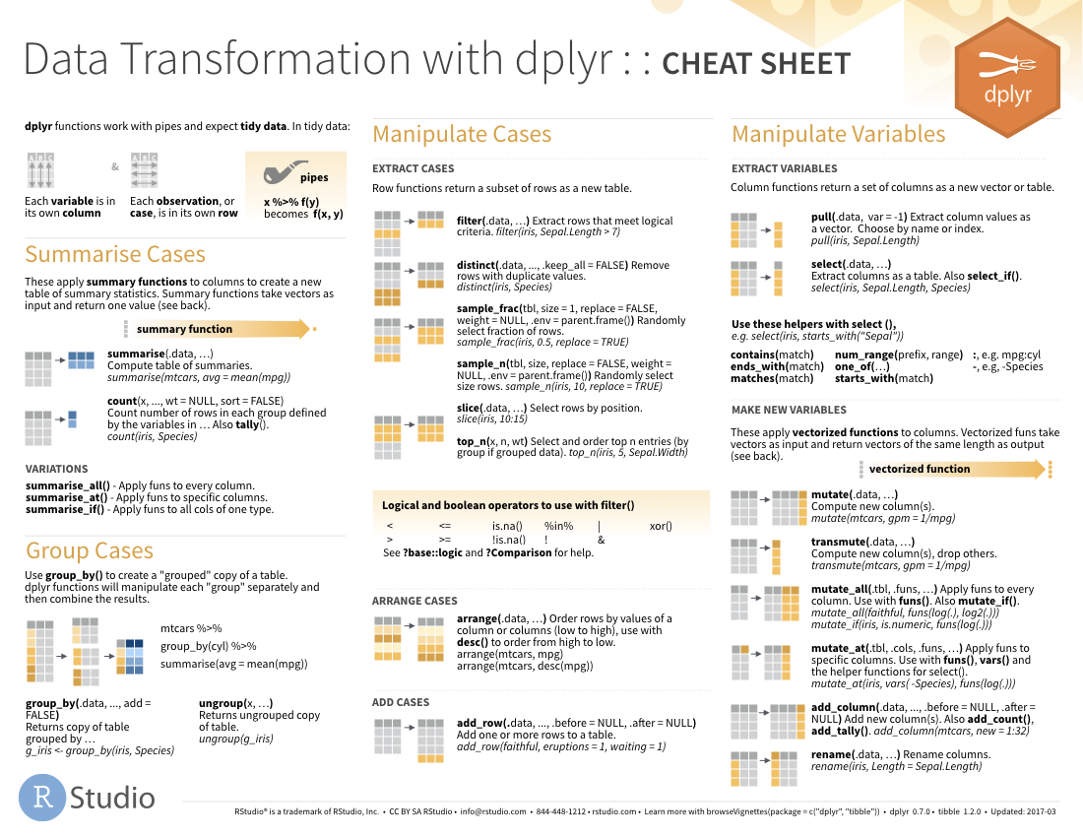
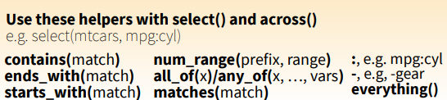
select() helpers
61

Slide 62
Quiz
Which of these is NOT a way to select the name and n columns together?
select(babynames, -c(year, sex, prop))
select(babynames, name:n)
select(babynames, starts_with("n"))
select(babynames, ends_with("n"))
62

Slide 63
Quiz
Which of these is NOT a way to select the name and n columns together?
select(babynames, -c(year, sex, prop))
select(babynames, name:n)
select(babynames, starts_with("n"))
select(babynames, ends_with("n"))
63

Slide 64
%>%

Slide 65
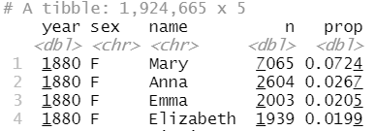
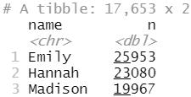
What was the most popular girls name in 2000?
What steps? What functions?

Slide 66
Steps
girls_2000 <- filter(babynames, year == 2000, sex == "F")
girls_2000 <- select(girls_2000, name, n)
girls_2000 <- arrange(girls_2000, desc(n))
girls_2000
66

Slide 67

Steps
girls_2000 <- filter(babynames, year == 2000, sex == "F")
girls_2000 <- select(girls_2000, name, n)
girls_2000 <- arrange(girls_2000, desc(n))
girls_2000
Don’t repeat yourself – we can do better!
67

Slide 68
Traditional approach
arrange(select(filter(babynames, year == 2000, sex == "F"), name, n), desc(n))
Is this better?
68

Slide 69
The pipe operator %>%
%>%
babynames %>% filter( , n == 99680)
Passes result on left into first argument of function on right.
So, these do the same thing. Try it (in a moment).
filter(babynames, n == 99680)
babynames %>% filter(n == 99680)
69

Slide 70
Pipes
babynames
boys_2015 <- filter(babynames, year == 2015, sex == "M")
boys_2015 <- select(boys_2015, name, n)
boys_2015 <- arrange(boys_2015, desc(n))
boys_2015
babynames %>%
filter(year == 2015, sex == "M") %>%
select(name, n) %>%
arrange(desc(n))

Slide 71
student <- "Aubrey"
student %>%
learn(R) %>%
analyse(data) %>%
receive(distinction)
vs.
student <- learn(student, R)
student <- analyse(student, data)
receive(student, distinction)
71

Slide 72
Shortcut to type %>%
Cmd
+
Shift
+
M
(Mac)
Ctrl
+
Shift
+
M
(Windows)
|> is Base R pipe – very similar
72

Slide 73
Your Turn 6
Use %>% to write a sequence of functions that:
Filters babynames to the boys that were born in 2017, then…
Selects the name and n columns, then…
Arranges the results so that the most popular names are at the top.
05:00
73

Slide 74
babynames %>%
filter(year == 2017, sex == "M") %>%
select(name, n) %>%
arrange(desc(n))
# name n
# 1 Emma 19738
# 2 Olivia 18632
# 3 Ava 15902
# 4 Isabella 15100
# 5 Sophia 14831
# 6 Mia 13437
# 7 Charlotte 12893
# 8 Amelia 11800
# 9 Evelyn 10675
## … with 20,170 more rows

Slide 75
Payoff!

Slide 76
Your Turn 7 - Exam
Trim babynames to just the rows that contain your name and your sex … or your favourite US name
Trim the result to just the columns that will appear in your graph (not necessary for graph, but useful when you display tables)
Plot the results as a line graph with year on the x axis and prop on the y axis
05:00
76

Slide 77
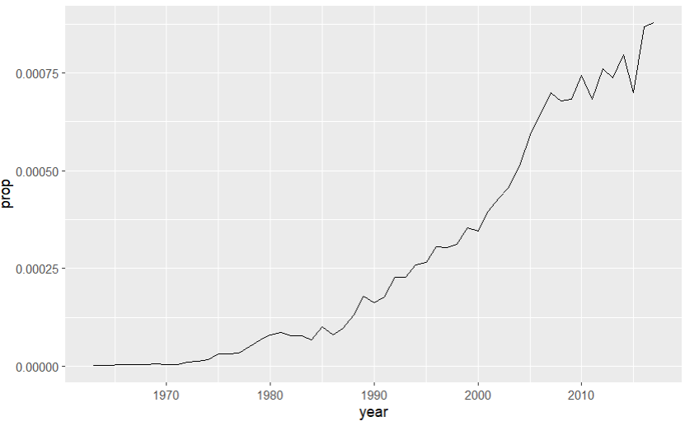
babynames %>%
filter(name == "Lukas", sex == "M") %>%
select(year, prop) %>%
ggplot(aes(x = year, y = prop)) +
geom_line()

Slide 78
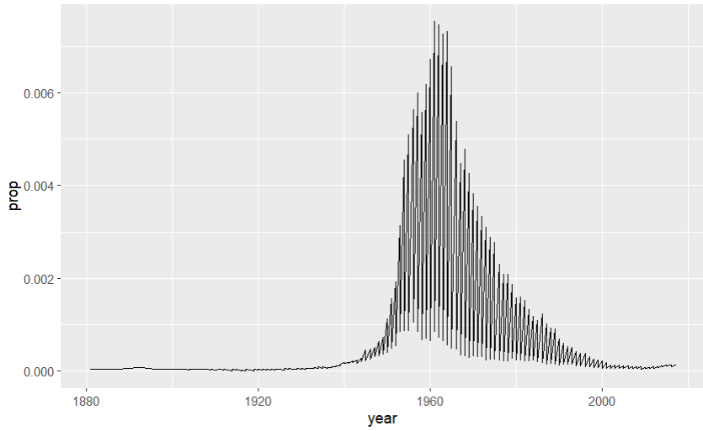
What’s going on?
babynames %>%
filter(name == "Robin") %>%
ggplot(aes(year, prop)) +
geom_line()

Slide 79
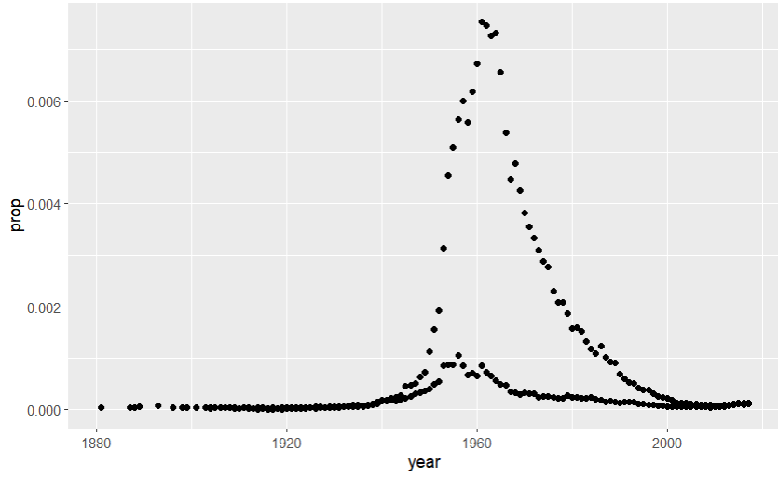
What’s going on?
babynames %>%
filter(name == "Robin") %>%
ggplot(aes(x = year, y = prop)) +
geom_point()
Did not filter on SEX

Slide 80
Plotting groups

Slide 81
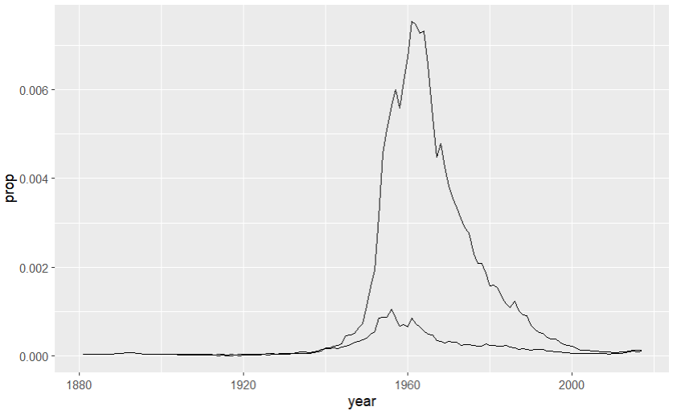
babynames %>%
filter(name == "Robin") %>%
ggplot(aes(x = year, y = prop, group = sex)) +
geom_line()

Slide 82
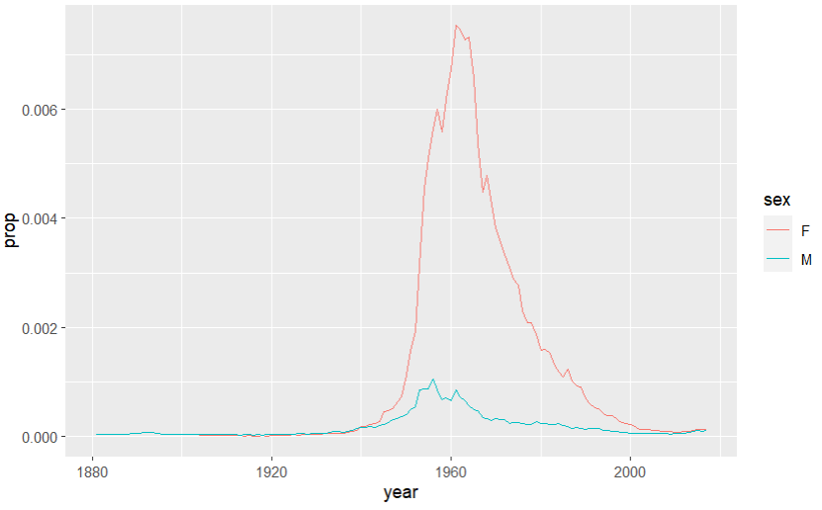
babynames %>%
filter(name == "Robin") %>%
ggplot(aes(year, prop, color = sex)) +
geom_line()

Slide 83
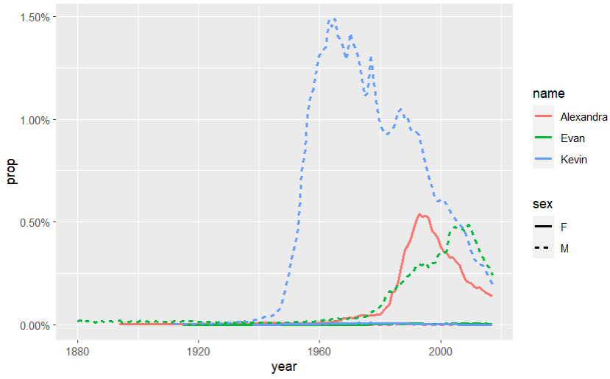
babynames %>% filter(name %in% c("Alexandra", "Evan", "Kevin")) %>% ggplot(aes(x = year, y = prop, color = name, linetype = sex)) + geom_line() + scale_y_continuous(labels = scales::label_percent())

Slide 84
What are the most popular names?

Slide 85
Quiz
Do we have enough information to:
Calculate the total number of children with each name?
85

Slide 86
Deriving information
summarise() - summarise variables
group_by() - group cases
mutate() - create new variables
86

Slide 87
summarise()

Slide 88
summarise()
Compute table of summaries.
babynames %>% summarise(total = sum(n), max = max(n))
babynames
year | sex | name | n | prop
1880 | M | John | 9655 | 0.0815
1880 | M | William | 9532 | 0.0805
1880 | M | James | 5927 | 0.0501
1880 | M | Charles | 5348 | 0.0451
1880 | M | Garrett | 13 | 0.0001
1881 | M | John | 8769 | 0.081
1881 | M | William | 8524 | 0.0787
1881 | M | James | 5442 | 0.0503
1881 | M | Charles | 4664 | 0.0431
1881 | M | Garrett | 7 | 0.0001
1881 | M | Gideon | 7 | 0.0001
total | max
348120517 | 99686
88

Slide 89
select()
Extract columns by name (or condition).
summarise(.data, …)
data frame to transform
name = function pairs, can use sum(), mean(), sd(),
min(), max(), median()…
89

Slide 90
Your Turn 8
Complete the code to extract the rows where name == "Khaleesi". Then use summarise() and sum() and min() to find:
The total number of children named Khaleesi
The first year Khaleesi appeared in the data
03:00
90

Slide 91
babynames %>%
filter(name == "Khaleesi") %>%
summarise(total = sum(n), first = min(year))
# total first
# 1 1964 2011
91

Slide 92
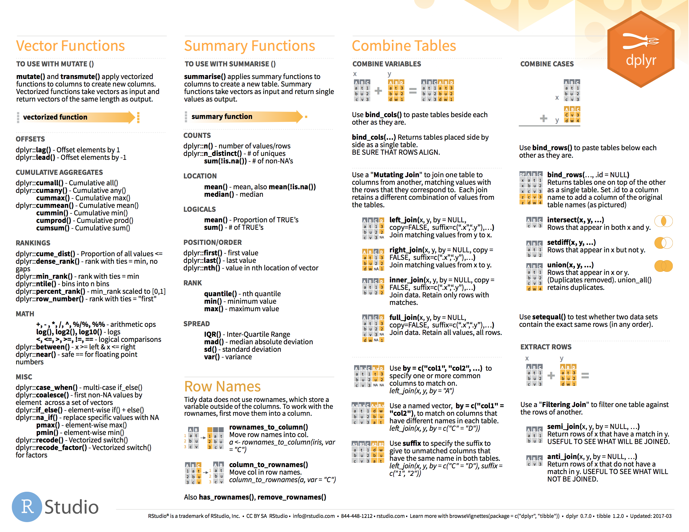
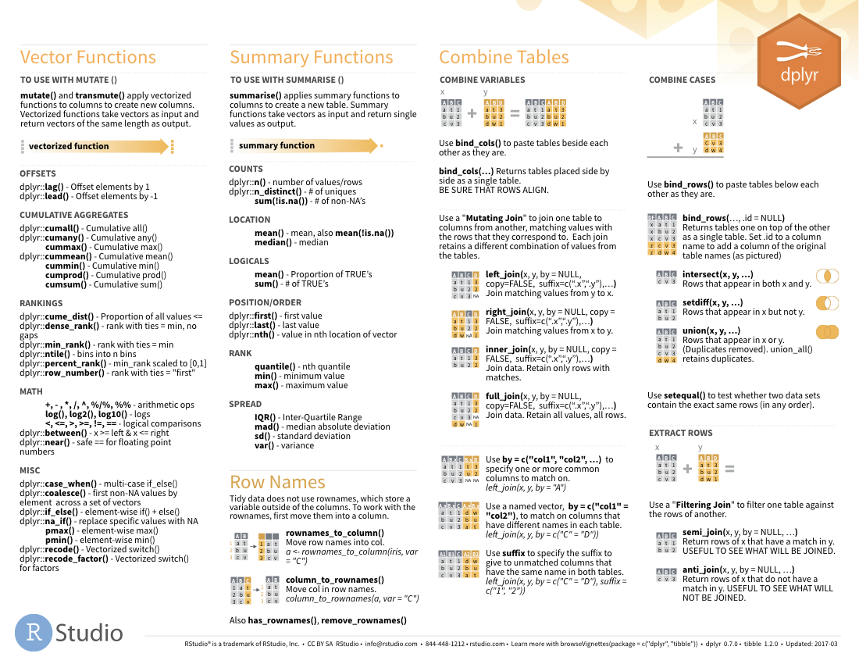

Summary functions
Take a vector as input.
Return a single value as output.
on 2nd page
92

Slide 93
n()
The number of rows in a dataset/group
babynames %>% summarise(n = n())
babynames
year | sex | name | n | prop
1880 | M | John | 9655 | 0.0815
1880 | M | William | 9532 | 0.0805
1880 | M | James | 5927 | 0.0501
1880 | M | Charles | 5348 | 0.0451
1880 | M | Garrett | 13 | 0.0001
1881 | M | John | 8769 | 0.081
1881 | M | William | 8524 | 0.0787
1881 | M | James | 5442 | 0.0503
1881 | M | Charles | 4664 | 0.0431
1881 | M | Garrett | 7 | 0.0001
1881 | M | Gideon | 7 | 0.0001
n
1924665
93

Slide 94
n_distinct()
The number of distinct values in a variable
babynames %>% summarise(n = n(), nname = n_distinct(name))
babynames
year | sex | name | n | prop
1880 | M | John | 9655 | 0.0815
1880 | M | William | 9532 | 0.0805
1880 | M | James | 5927 | 0.0501
1880 | M | Charles | 5348 | 0.0451
1880 | M | Garrett | 13 | 0.0001
1881 | M | John | 8769 | 0.081
1881 | M | William | 8524 | 0.0787
1881 | M | James | 5442 | 0.0503
1881 | M | Charles | 4664 | 0.0431
1881 | M | Garrett | 7 | 0.0001
1881 | M | Gideon | 7 | 0.0001
n | nname
1924665 | 97310
94

Slide 95
How should we define popularity?
A name is popular if:
Sums - a large number of children have the name when you sum across years
Ranks - it consistently ranks among the top names from year to year.
95

Slide 96
babynames %>%
filter(name == "Khaleesi" & sex == "F")
## year sex name n prop
## 1 2011 F Khaleesi 28 0.0000145
## 2 2012 F Khaleesi 146 0.0000754
## 3 2013 F Khaleesi 243 0.000126
## 4 2014 F Khaleesi 369 0.000189
## 5 2015 F Khaleesi 341 0.000175
## 6 2016 F Khaleesi 371 0.000192
## 7 2017 F Khaleesi 466 0.000249

Slide 97
babynames %>%
filter(name == "Khaleesi" & sex == "F") %>%
summarise(total = sum(n))
## total
## 1 1964
Can we do this for
each name?

Slide 98
Grouping
cases

Slide 99
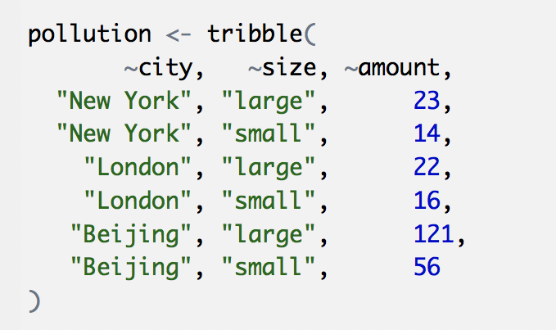
pollution
city | particle size | amount (µg/m³)
New York | large | 23
New York | small | 14
London | large | 22
London | small | 16
Beijing | large | 121
Beijing | small | 56
99

Slide 100
city | particle size | amount (µg/m³)
New York | large | 23
New York | small | 14
London | large | 22
London | small | 16
Beijing | large | 121
Beijing | small | 56
mean | sum | n
42 | 252 | 6
pollution %>%
summarise(mean = mean(amount), sum = sum(amount), n = n())

Slide 101
city | particle size | amount (µg/m³)
New York | large | 23
New York | small | 14
London | large | 22
London | small | 16
Beijing | large | 121
Beijing | small | 56
mean | sum | n
42 | 252 | 6

Slide 102
city | particle size | amount (µg/m³)
New York | large | 23
New York | small | 14
mean | sum | n
42 | 252 | 6
London | large | 22
London | small | 16
Beijing | large | 121
Beijing | small | 56

Slide 103
city | particle size | amount (µg/m³)
New York | large | 23
New York | small | 14
mean | sum | n
18.5 | 37 | 2
mean | sum | n
18.5 | 37 | 2
London | large | 22
London | small | 16
19.0 | 38 | 2
19.0 | 38 | 2
Beijing | large | 121
Beijing | small | 56
88.5 | 177 | 2
88.5 | 177 | 2
group_by() + summarise()

Slide 104
group_by()
Groups cases by common values of one or more columns.
pollution %>%
group_by(city)
babynames %>% group_by(sex)
# A tibble: 6 x 3
# Groups: city [3]
city size amount
<chr> <chr> <dbl>
1 New York large 23
2 New York small 14
3 London large 22
4 London small 16
5 Beijing large 121
6 Beijing small 56

Slide 105
group_by()
city | particle size | amount (µg/m³)
New York | large | 23
New York | small | 14
city | particle size | amount (µg/m³)
New York | large | 23
New York | small | 14
city | mean | sum | n
New York | 18.5 | 37 | 2
London | 19.0 | 38 | 2
Beijing | 88.5 | 177 | 2
London | large | 22
London | small | 16
London | large | 22
London | small | 16
Beijing | large | 121
Beijing | small | 56
Beijing | large | 121
Beijing | small | 56
pollution %>%
group_by(city) %>%
summarise(mean = mean(amount), sum = sum(amount), n = n())

Slide 106
group_by()
city | particle size | amount (µg/m³)
New York | large | 23
city | particle size | amount (µg/m³)
New York | large | 23
New York | small | 14
city | particle size | mean | sum | n
New York | large | 23 | 23 | 1
New York | small | 14 | 14 | 1
London | large | 22 | 22 | 1
London | small | 16 | 16 | 1
Beijing | large | 121 | 121 | 1
Beijing | small | 56 | 56 | 1
New York | small | 14
London | large | 22
London | large | 22
London | small | 16
London | small | 16
Beijing | large | 121
Beijing | small | 56
Beijing | large | 121
Beijing | small | 56
pollution %>%
group_by(city, size) %>%
summarise(mean = mean(amount), sum = sum(amount), n = n())

Slide 107
group_by()
Groups cases by common values.
babynames %>%
group_by(sex) %>%
summarise(total = sum(n), .groups = "drop")
sex | total
F | 172371079
M | 175749438
107

Slide 108
ungroup()
Removes grouping criteria from a data frame.
babynames %>%
group_by(sex) %>%
ungroup() %>%
summarise(total = sum(n))
total
348120517
108

Slide 109
Your Turn 9
Complete the code with group_by(), summarise(), and arrange() to display the ten most popular name and sex combinations. Compute popularity as the total number of children with a given name and sex.
03:00
109

Slide 110
babynames %>%
group_by(name, sex) %>%
summarise(total = sum(n), .groups = "drop") %>%
arrange(desc(total))
# name sex total
# 1 James M 5120990
# 2 John M 5095674
# 3 Robert M 4803068
# 4 Michael M 4323928
# 5 Mary F 4118058
# 6 William M 4071645
# 7 David M 3589754
# 8 Joseph M 2581785
# 9 Richard M 2558165
# 10 Charles M 2371621
# … with 107,963 more rows

Slide 111
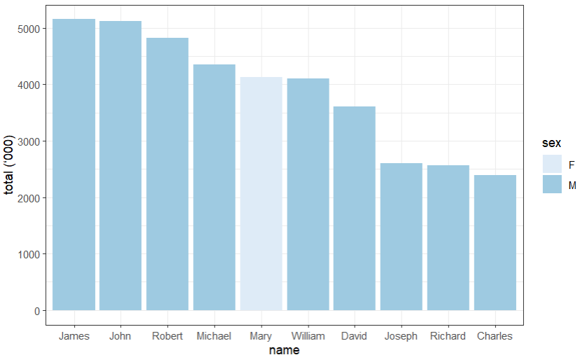

Slide 112
babynames %>%
group_by(name, sex) %>%
summarise(total = sum(n), .groups = "drop") %>%
arrange(desc(total)) %>%
slice_head(n = 10) %>%
ggplot(aes(x = fct_reorder(name, desc(total)), y = total/1000, fill = sex)) +
geom_col() +
theme_bw() +
scale_fill_brewer() +
labs(x = "name", y = "total (‘000)")

Slide 113
babynames %>%
filter(name == "Khaleesi" & sex == "F") %>%
summarise(total = sum(n))
## total
## 1 1964
Can we do this for
each name?

Slide 114

babynames %>%
filter(name == "Khaleesi" & sex == "F") %>%
summarise(total = sum(n))
babynames %>%
group_by(name, sex) %>%
summarise(total = sum(n))
Group by the variables you used to get your test case

Slide 115
babynames %>%
filter(name == "Khaleesi" & sex == "F") %>%
summarise(total = sum(n))
babynames %>%
group_by(name, sex) %>%
summarise(total = sum(n), .groups = "drop") %>%
arrange(desc(total))

Slide 116
How should we define popularity?
A name is popular if:
Sums - a large number of children have the name when you sum across years
Ranks - it consistently ranks among the top names from year to year.
How could this
be biased?
116

Slide 117
babynames %>%
filter(year == 2017) %>%
summarise(total = sum(n))
## total
## 1 3546301
babynames %>%
filter(year == 1880) %>%
summarise(total = sum(n))
## total
## 1 201484
3,546,301
201,484

Slide 118
Your Turn 10
Use group_by() to calculate the total number of children born for every year.
Plot the results as a line graph: total vs. year.
03:00
118

Slide 119
babynames %>%
group_by(year) %>%
summarise(n_children = sum(n)) %>%
ggplot(aes(x = year, y = n_children)) +
geom_line()
119

Slide 120
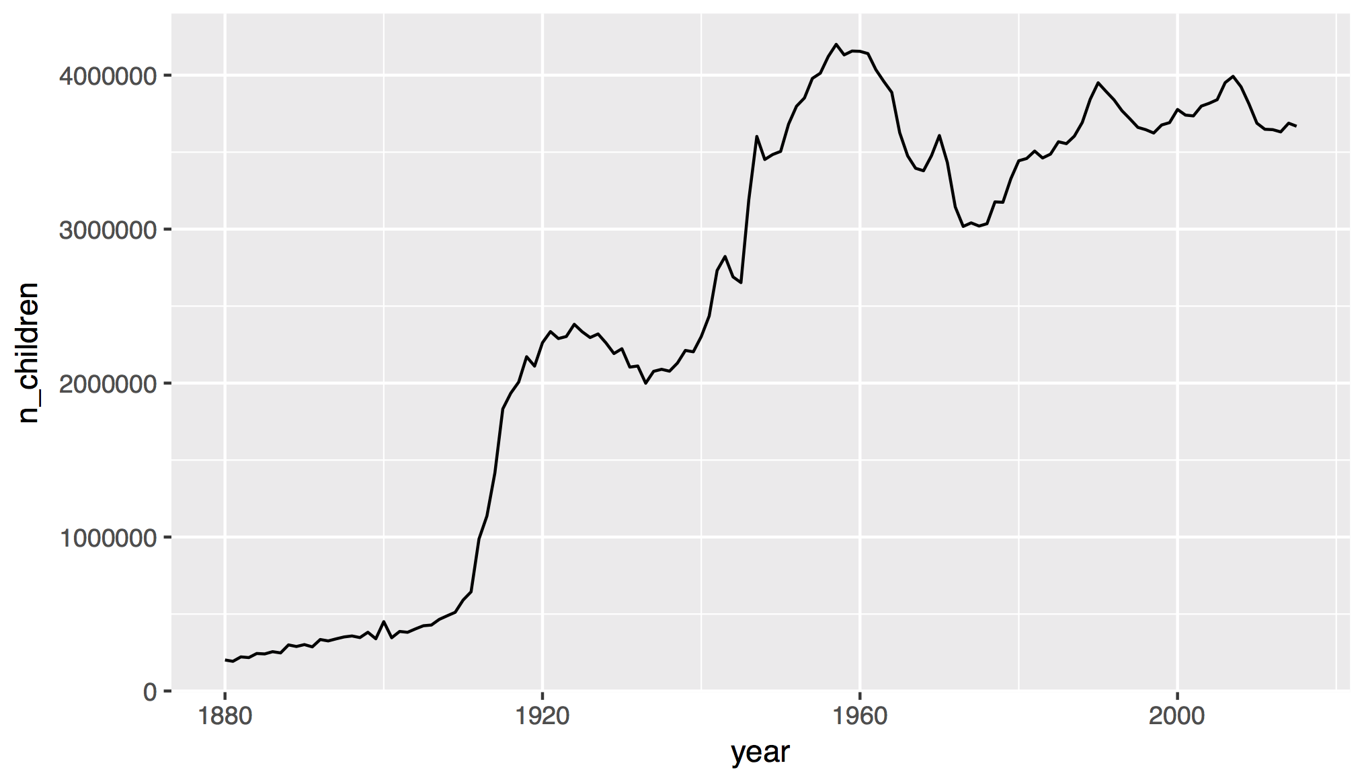
120

Slide 121
How should we define popularity?
A name is popular if:
Sums - a large number of children have the name when you sum across years
Ranks - it consistently ranks among the top names from year to year.
121

Slide 122
Quiz
Do we have enough information to:
Rank names within each year?
122

Slide 123
mutate()

Slide 124
mutate()
Create new columns.
babynames %>%
mutate(percent = round(prop*100, 2))
babynames
year | sex | name | n | prop
1880 | M | John | 9655 | 0.0815
1880 | M | William | 9532 | 0.0805
1880 | M | James | 5927 | 0.0501
1880 | M | Charles | 5348 | 0.0451
1880 | M | Garrett | 13 | 0.0001
1881 | M | John | 8769 | 0.081
1881 | M | William | 8524 | 0.0787
1881 | M | James | 5442 | 0.0503
1881 | M | Charles | 4664 | 0.0431
1881 | M | Garrett | 7 | 0.0001
1881 | M | Gideon | 7 | 0.0001
year | sex | name | n | prop | percent
1880 | M | John | 9655 | 0.0815 | 8.15
1880 | M | William | 9532 | 0.0805 | 8.05
1880 | M | James | 5927 | 0.0501 | 5.01
1880 | M | Charles | 5348 | 0.0451 | 4.51
1880 | M | Garrett | 13 | 0.0001 | 0.01
1881 | M | John | 8769 | 0.081 | 8.1
1881 | M | William | 8524 | 0.0787 | ratio
1881 | M | James | 5442 | 0.0503 | 9.15
1881 | M | Charles | 4664 | 0.0431 | 22.42
1881 | M | Garrett | 7 | 0.0001 | 15.46
1881 | M | Gideon | 7 | 0.0001 | 25.32

Slide 125
mutate()
Create new columns.
babynames %>%
mutate(percent = round(prop*100, 2), nper = round(percent))
babynames
year | sex | name | n | prop
1880 | M | John | 9655 | 0.0815
1880 | M | William | 9532 | 0.0805
1880 | M | James | 5927 | 0.0501
1880 | M | Charles | 5348 | 0.0451
1880 | M | Garrett | 13 | 0.0001
1881 | M | John | 8769 | 0.081
1881 | M | William | 8524 | 0.0787
1881 | M | James | 5442 | 0.0503
1881 | M | Charles | 4664 | 0.0431
1881 | M | Garrett | 7 | 0.0001
1881 | M | Gideon | 7 | 0.0001
year | sex | name | n | prop | percent | nper
1880 | M | John | 9655 | 0.0815 | 8.15 | 8
1880 | M | William | 9532 | 0.0805 | 8.05 | 8
1880 | M | James | 5927 | 0.0501 | 5.01 | 5
1880 | M | Charles | 5348 | 0.0451 | 4.51 | 5
1880 | M | Garrett | 13 | 0.0001 | 0.01 | 0
1881 | M | John | 8769 | 0.081 | 8.1 | 8
1881 | M | William | 8524 | 0.0787 | ratio
1881 | M | James | 5442 | 0.0503 | 9.15
1881 | M | Charles | 4664 | 0.0431 | 22.42
1881 | M | Garrett | 7 | 0.0001 | 15.46
1881 | M | Gideon | 7 | 0.0001 | 25.32

Slide 126
babynames %>%
mutate(rank = min_rank(desc(prop)))
?

Slide 127
Vectorized functions
Take a vector as input.
Return a vector of the same length as output.
on back
127

Slide 128
min_rank()
A go-to ranking function (ties share the lowest rank)
min_rank(c(50, 100, 100, 1000))
# [1] 1 2 2 4
min_rank(desc(c(50, 100, 100, 1000)))
# [1] 4 2 2 1
128

Slide 129
Your Turn 11
Rank the names
Fill in the blanks to rank each name within its year and sex.
02:00
129

Slide 130
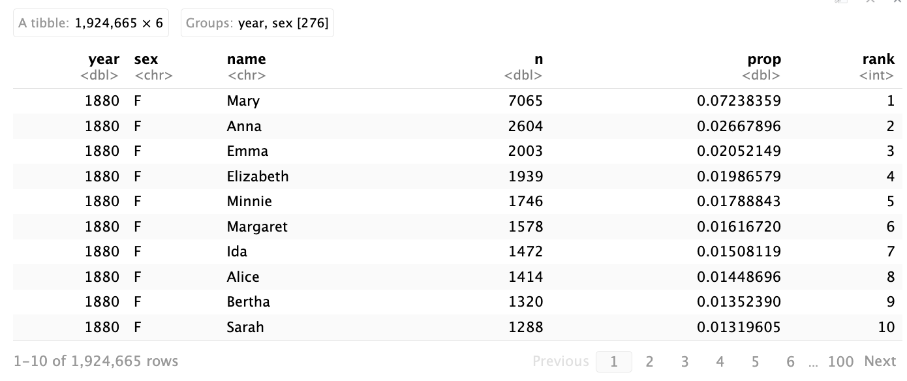
babynames %>%
group_by(year, sex) %>%
mutate(rank = min_rank(desc(n)))

Slide 131
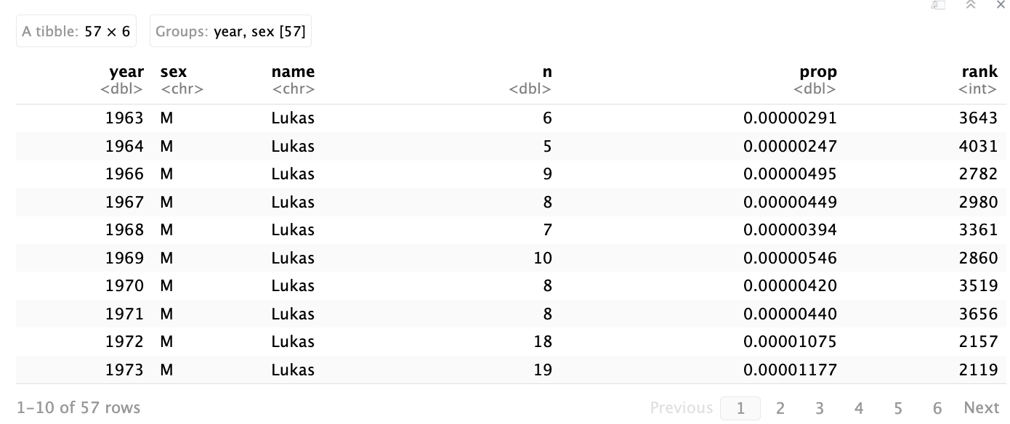
babynames %>%
group_by(year, sex) %>%
mutate(rank = min_rank(desc(n))) %>%
filter(name == "Lukas")

Slide 132
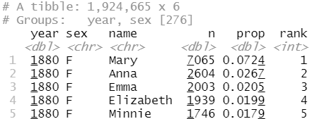
Step 1
Rank the names for each year and sex
132

Slide 133
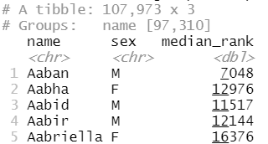
Step 2
Rank the names for each year and sex
Compute the median rank for each name
133

Slide 134
Your Turn 12
Calculate the median ranks
Fill in the blanks to compute the median of the ranks for each name (i.e., for each combination of name and sex). Arrange the results from highest median rank to lowest.
03:00
134

Slide 135
babynames %>%
group_by(year, sex) %>%
mutate(rank = min_rank(desc(prop))) %>%
group_by(name, sex) %>%
summarise(median_rank = median(rank)) %>%
arrange(median_rank)
# name sex score
# 1 Mary F 1
# 2 James M 3
# 3 John M 3
# 4 William M 4
# 5 Robert M 6
# … with 107,963 more rows
135

Slide 136
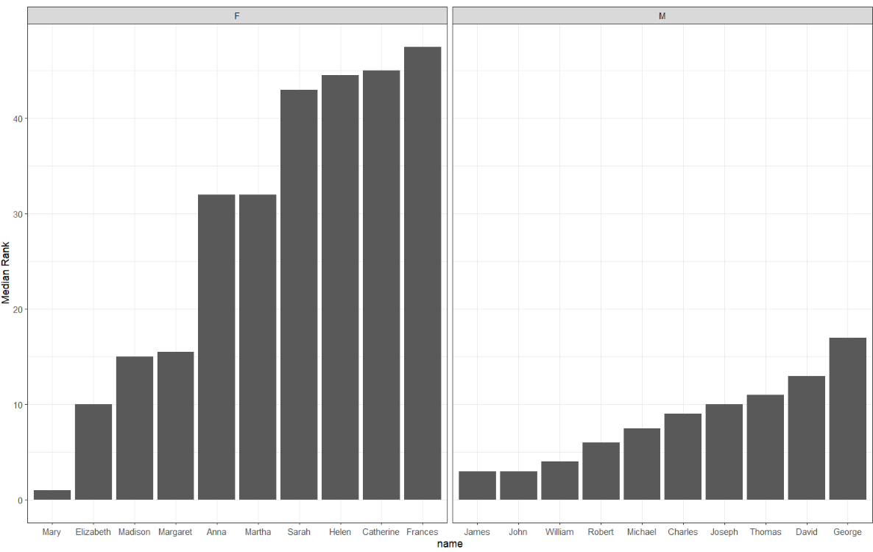

Slide 137
babynames %>%
group_by(year, sex) %>%
mutate(rank = min_rank(desc(prop))) %>%
group_by(name, sex) %>%
summarise(median_rank = median(rank)) %>%
group_by(sex) %>%
arrange(median_rank) %>%
slice_min(median_rank, n = 10) %>%
ggplot() +
geom_col(mapping = aes(x = fct_reorder(name, median_rank), y = median_rank)) +
facet_wrap(vars(sex), scales = "free_x") +
theme_bw() +
labs(x = "name", y = "Median Rank")

Slide 138
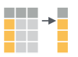
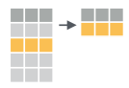
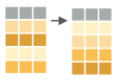
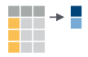
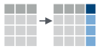
Recap: Single table verbs
Extract variables with select()
Extract cases with filter()
Arrange cases, with arrange() + desc().
Make tables of summaries with summarise().
Make new variables, with mutate().
138

Slide 139
$

Slide 140

select()
Extract columns by name.
select(babynames, n)
babynames
year | sex | name | n | prop
1880 | M | John | 9655 | 0.0815
1880 | M | William | 9532 | 0.0805
1880 | M | James | 5927 | 0.0501
1880 | M | Charles | 5348 | 0.0451
1880 | M | Garrett | 13 | 0.0001
1881 | M | John | 8769 | 0.081
1881 | M | William | 8524 | 0.0787
1881 | M | James | 5442 | 0.0503
1881 | M | Charles | 4664 | 0.0431
1881 | M | Garrett | 7 | 0.0001
1881 | M | Gideon | 7 | 0.0001
n
9655
9532
5927
5348
13
8769
8524
5442
4664
7
7
Still a dataframe

Slide 141
$
Extract column contents as a vector.
babynames$n
babynames
year | sex | name | n | prop
1880 | M | John | 9655 | 0.0815
1880 | M | William | 9532 | 0.0805
1880 | M | James | 5927 | 0.0501
1880 | M | Charles | 5348 | 0.0451
1880 | M | Garrett | 13 | 0.0001
1881 | M | John | 8769 | 0.081
1881 | M | William | 8524 | 0.0787
1881 | M | James | 5442 | 0.0503
1881 | M | Charles | 4664 | 0.0431
1881 | M | Garrett | 7 | 0.0001
1881 | M | Gideon | 7 | 0.0001
9655 9532 5927 5348 …

Slide 142
$
Extract column contents as a vector (or extract value from other object type)
babynames$n
data frame (or object)
$
column name w/o quotes
(or value name)
142

Slide 143
pull()
Pipe friendly version of $
babynames %>% pull(n)
babynames
year | sex | name | n | prop
1880 | M | John | 9655 | 0.0815
1880 | M | William | 9532 | 0.0805
1880 | M | James | 5927 | 0.0501
1880 | M | Charles | 5348 | 0.0451
1880 | M | Garrett | 13 | 0.0001
1881 | M | John | 8769 | 0.081
1881 | M | William | 8524 | 0.0787
1881 | M | James | 5442 | 0.0503
1881 | M | Charles | 4664 | 0.0431
1881 | M | Garrett | 7 | 0.0001
1881 | M | Gideon | 7 | 0.0001
9655 9532 5927 5348 …

Slide 144
Transform Data with

